Slide 1
Neural constraints on learning A modeling approach
Kaifeng Sheng

Slide 2
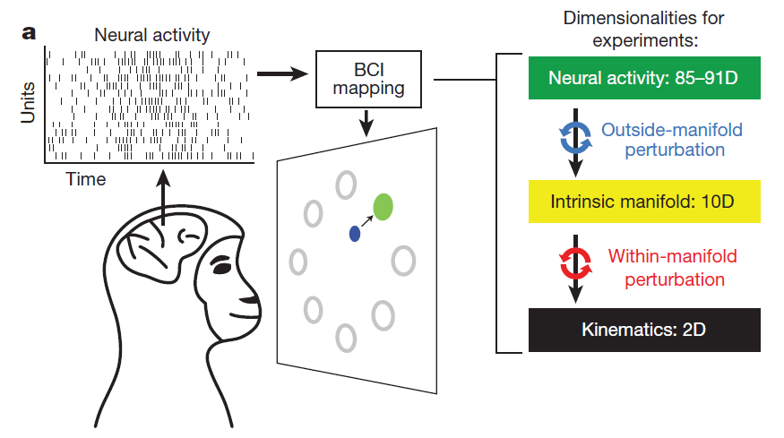
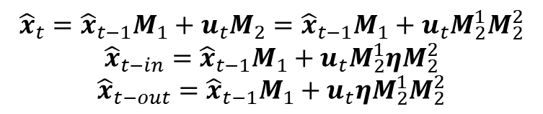
Origin
Ref: Yu, Batista, etc. Nature, 2014
$${\hat{x}}_{t}={\hat{x}}_{t−1}M_{1}+u_{t}M_{2}={\hat{x}}_{t−1}M_{1}+u_{t}M_{2}^{1}M_{2}^{2}$$
$${\hat{x}}_{t−in}={\hat{x}}_{t−1}M_{1}+u_{t}M_{2}^{1}{ηM}_{2}^{2}$$
$${\hat{x}}_{t−out}={\hat{x}}_{t−1}M_{1}+u_{t}ηM_{2}^{1}M_{2}^{2}$$

Slide 3
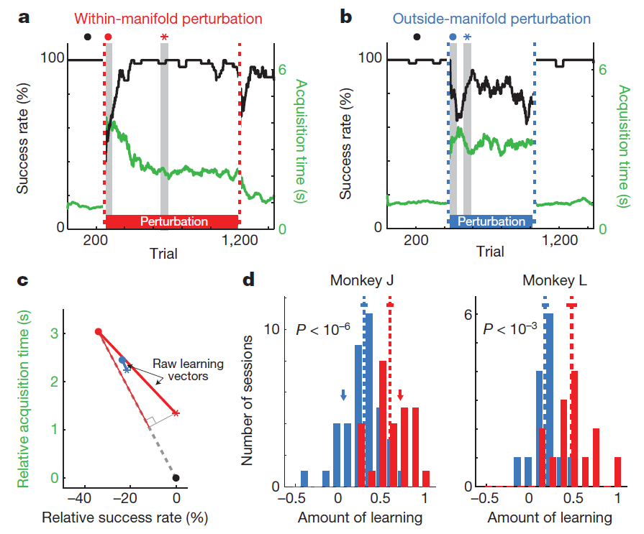

Slide 4
Introduction
Purpose: Explaining the underlying mechanism of the manifold constrain on learning by first building a biologically plausible RNN model of the motor cortex, then test different hypotheses for the learning mechanism on the model.
Design of the basic model → Learning behavior on different perturbations → Improved model → Different metrics of biological plausibility → hypotheses of learning mechanism

Slide 5
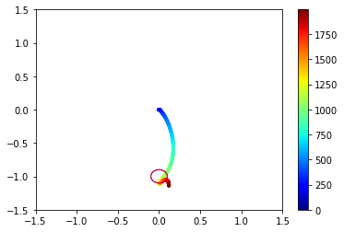
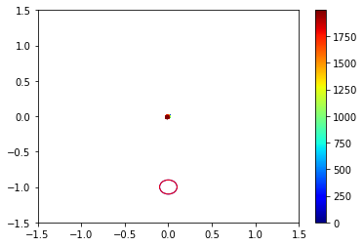
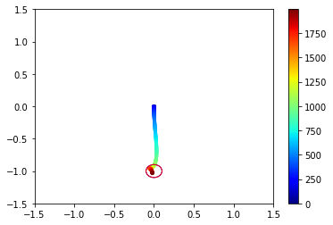
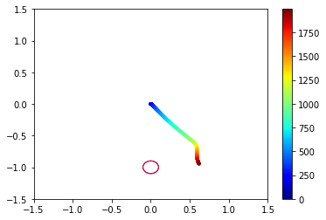
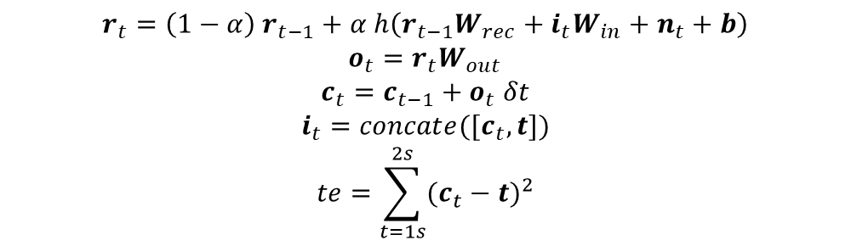
Basic Model
Cursor movement
MOTOR CORTEX
C
TE
T
$$r_{t}=\left(1−α\right) r_{t−1}+α h\left(r_{t−1}W_{rec}+i_{t}W_{in}+n_{t}+b\right)$$
$$o_{t}=r_{t}W_{out}$$
$$c_{t}=c_{t−1}+o_{t} δt$$
$$i_{t}=concate([c_{t}, t])$$
$$te=\sum_{t=1s}^{2s}{{(c_{t}−t)}^{2}}$$

Slide 6
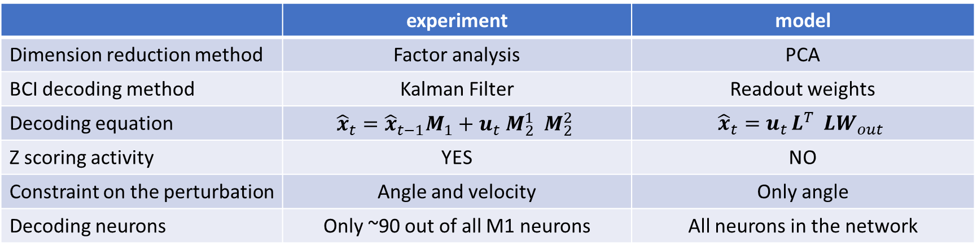
Difference between the experiment and my model
 | experiment | model
Dimension reduction method | Factor analysis | PCA
BCI decoding method | Kalman Filter | Readout weights
Decoding equation | $${\hat{x}}_{t}={\hat{x}}_{t−1}M_{1}+u_{t}{ M}_{2}^{1}{ M}_{2}^{2}$$ | $${\hat{x}}_{t}=u_{t }L^{T} LW_{out}$$
Z scoring activity | YES | NO
Constraint on the perturbation | Angle and velocity | Only angle
Decoding neurons | Only ~90 out of all M1 neurons | All neurons in the network

Slide 7
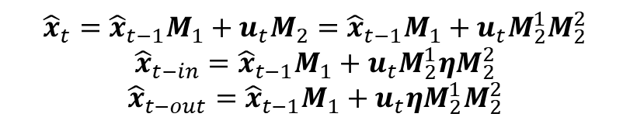
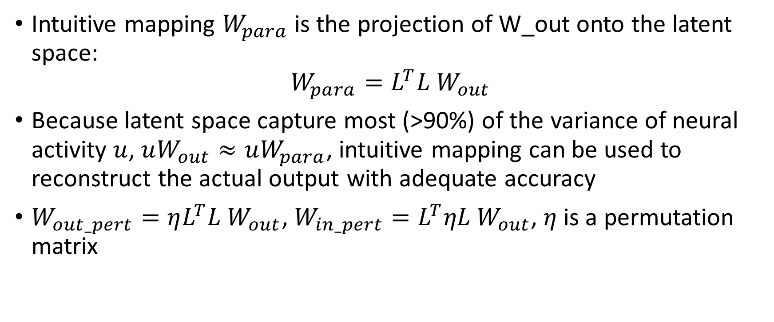
Definition of intuitive and perturbed mapping W_parallel, W_perturbation
Intuitive mapping $W_{para}$ is the projection of W_out onto the latent space:
$$W_{para}=L^{T}L W_{out}$$
Because latent space capture most (>90%) of the variance of neural activity $u$, $uW_{out}≈uW_{para}$, intuitive mapping can be used to reconstruct the actual output with adequate accuracy
$W_{out_pert}=ηL^{T}L W_{out}$, $W_{in_pert}=L^{T}ηL W_{out}$, $η$ is a permutation matrix
$${\hat{x}}_{t}={\hat{x}}_{t−1}M_{1}+u_{t}M_{2}={\hat{x}}_{t−1}M_{1}+u_{t}M_{2}^{1}M_{2}^{2}$$
$${\hat{x}}_{t−in}={\hat{x}}_{t−1}M_{1}+u_{t}M_{2}^{1}{ηM}_{2}^{2}$$
$${\hat{x}}_{t−out}={\hat{x}}_{t−1}M_{1}+u_{t}ηM_{2}^{1}M_{2}^{2}$$

Slide 8
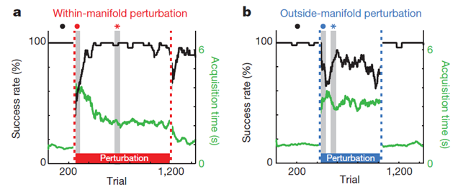
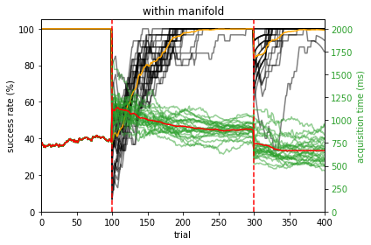
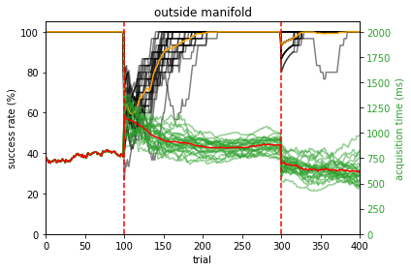
Learning result

Slide 9
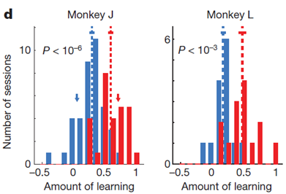
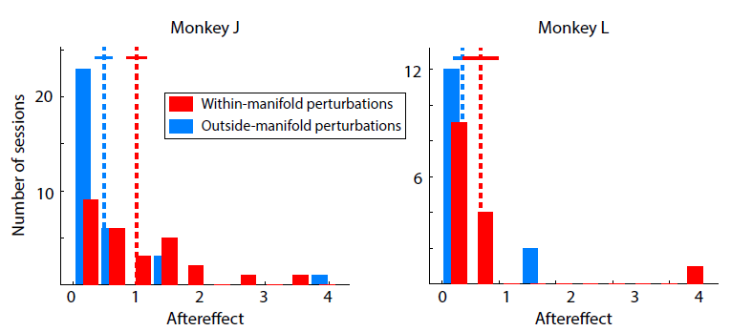
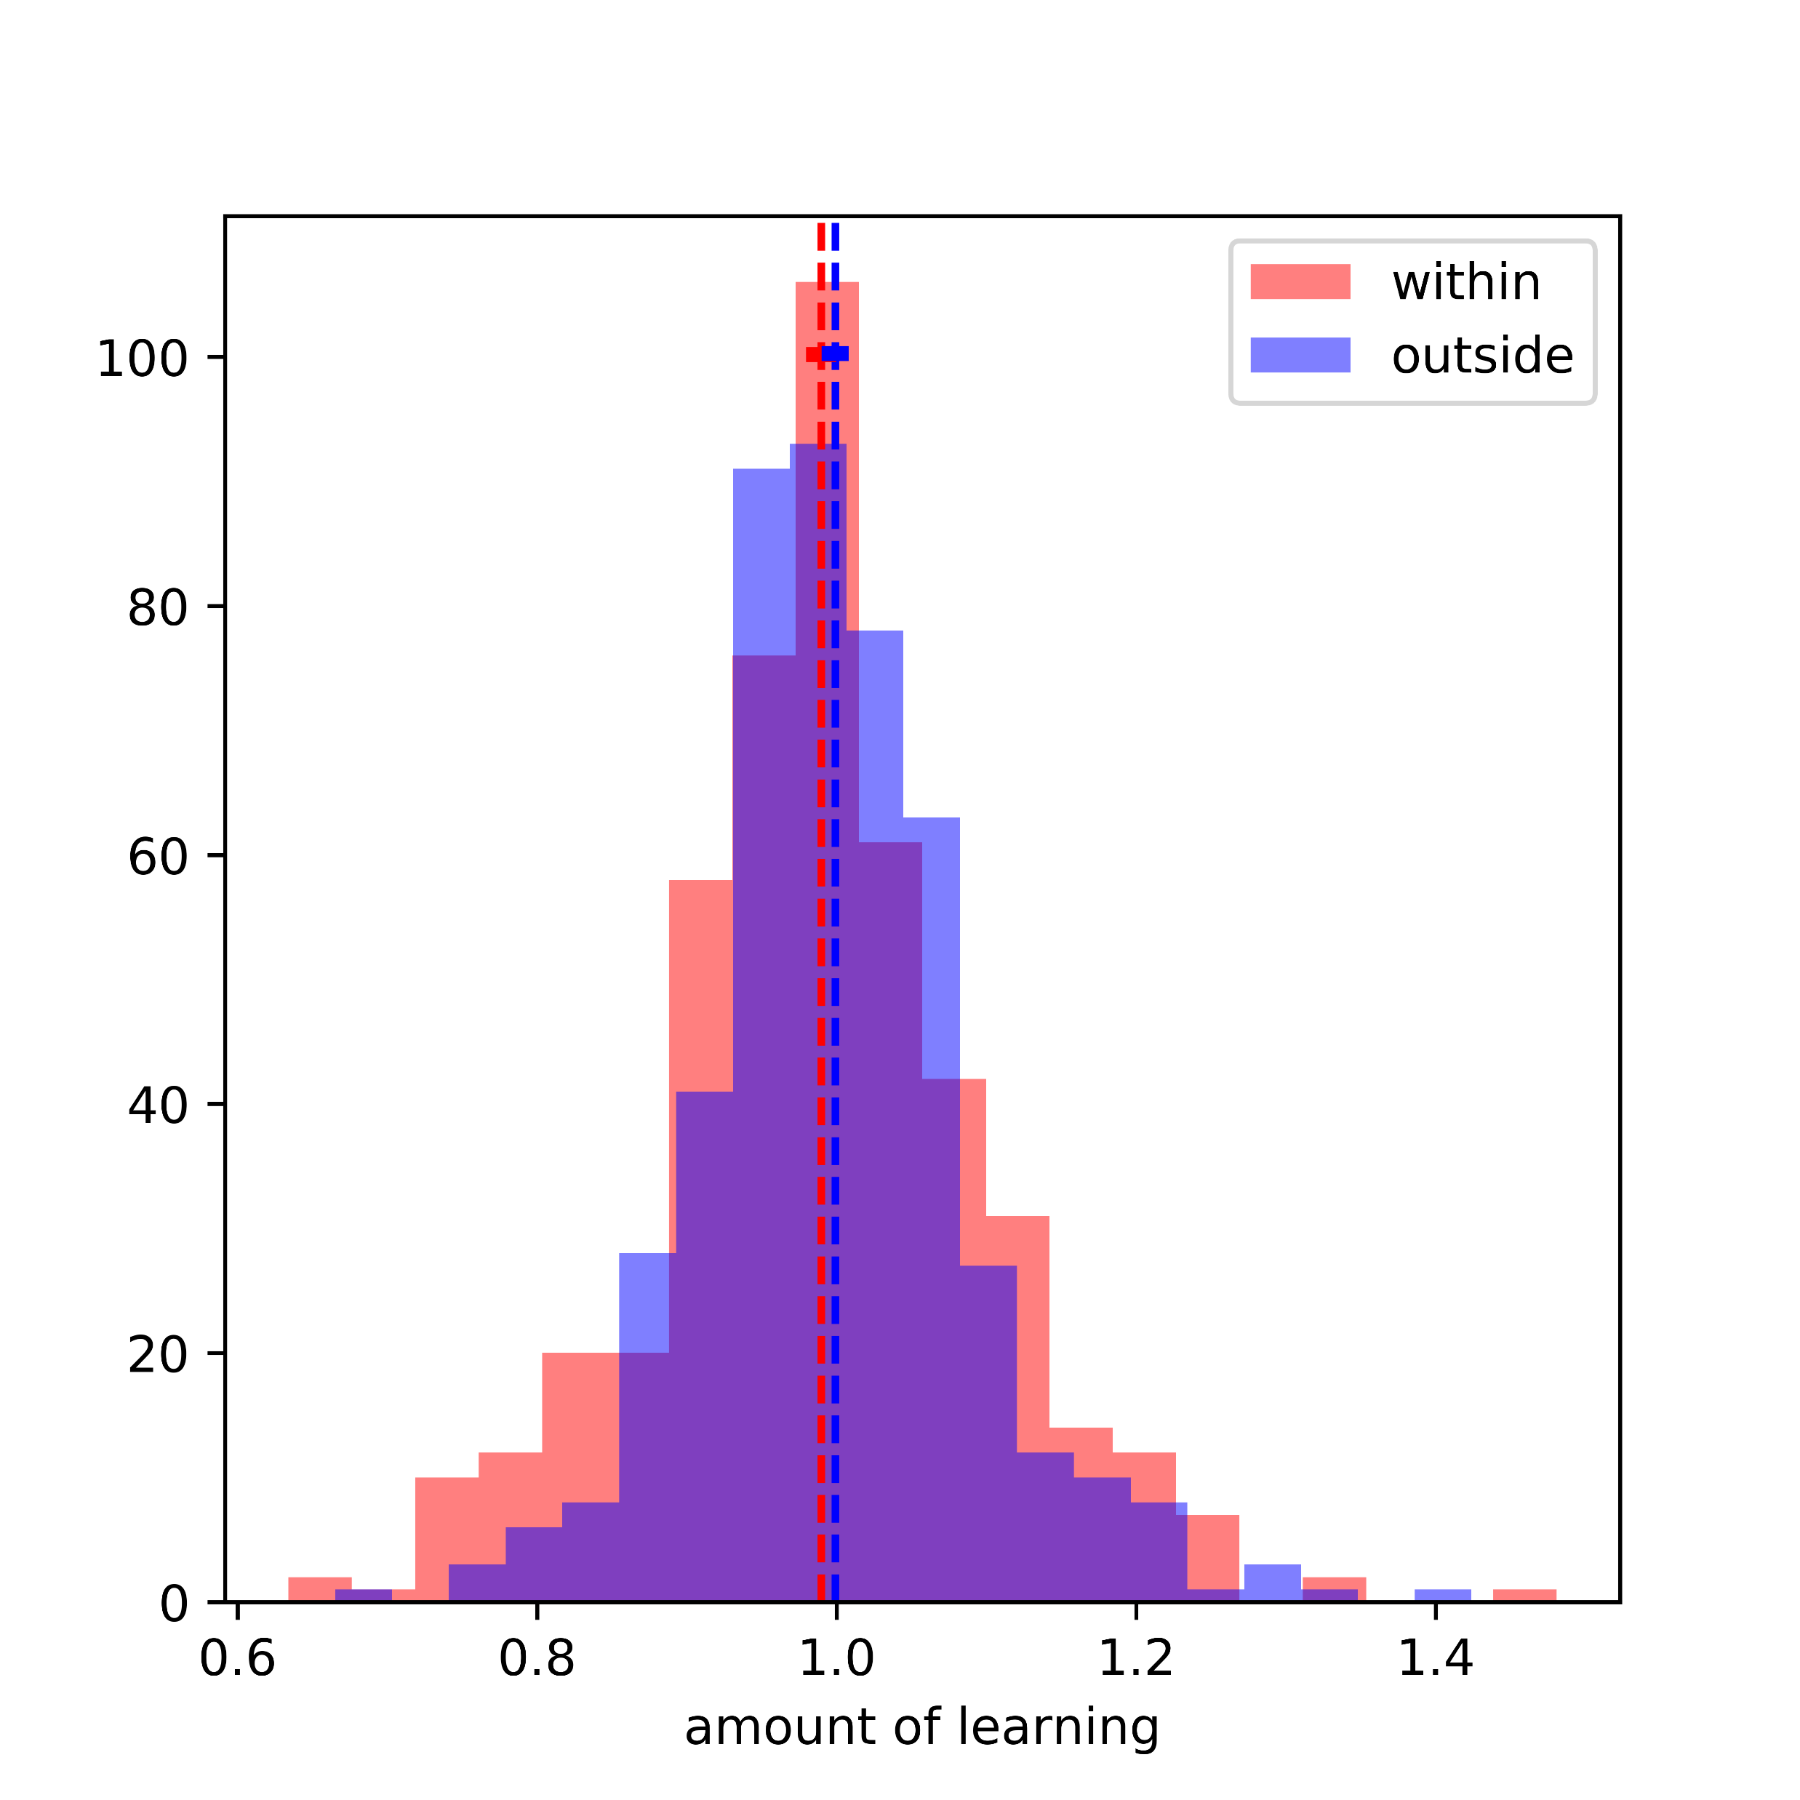
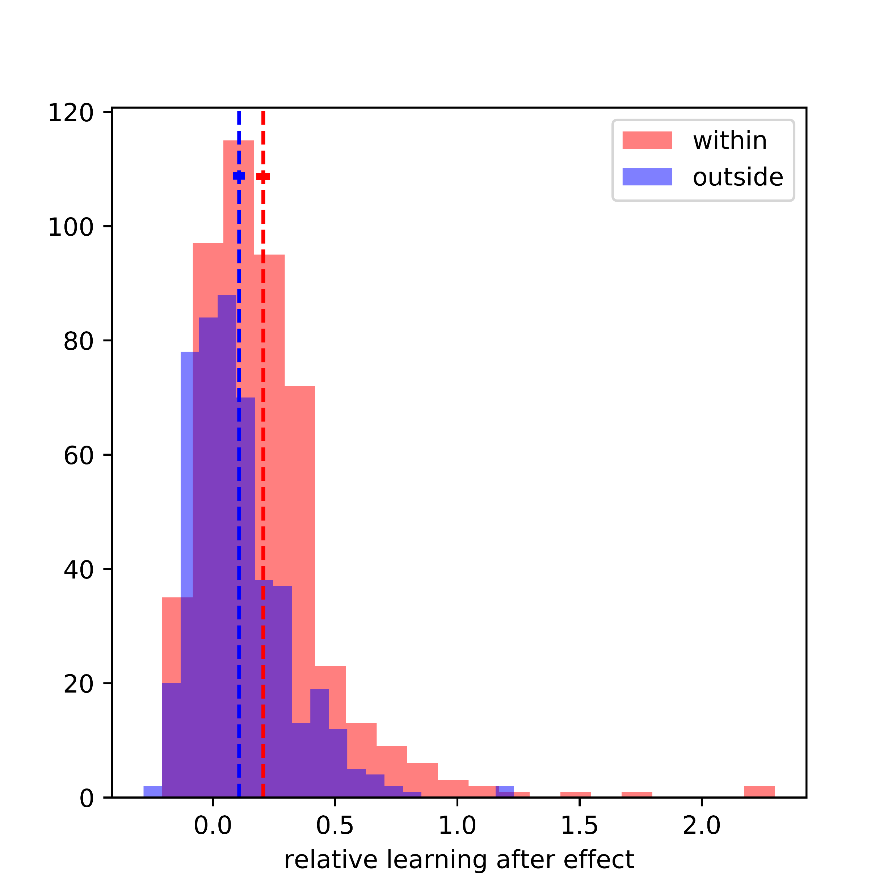

Slide 10
What’s the problem?
Training method pass gradient through the perturbation (perturbed output weight), which means full knowledge of the perturbation
In experiment, monkey only don’t have full access to the BCI decoding method, but instead can only estimate the behavior of the BCI readout in regard to each neural activity
MOTOR CORTEX
C
TE
T

Slide 11

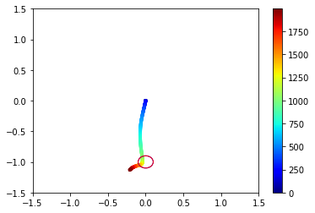

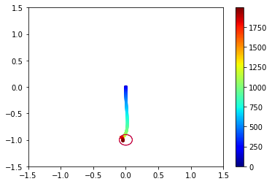
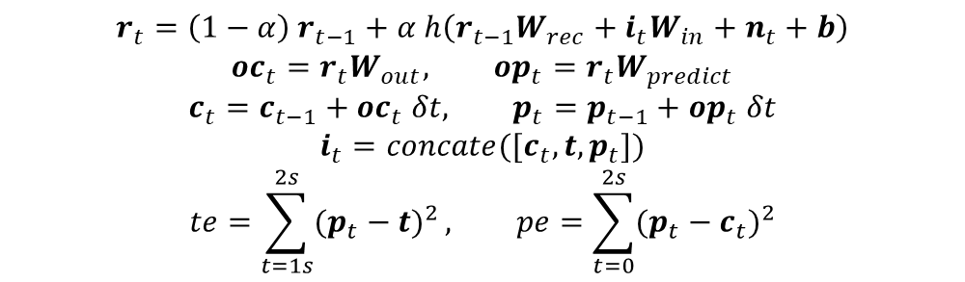
Prediction Model
Predicted movement
MOTOR CORTEX
C
PE
Cursor movement
P
TE
T
$$r_{t}=\left(1−α\right) r_{t−1}+α h\left(r_{t−1}W_{rec}+i_{t}W_{in}+n_{t}+b\right)$$
$${oc}_{t}=r_{t}W_{out}, {op}_{t}=r_{t}W_{predict}$$
$$c_{t}=c_{t−1}+{oc}_{t} δt, p_{t}=p_{t−1}+{op}_{t} δt$$
$$i_{t}=concate([c_{t}, t,p_{t}])$$
$$te=\sum_{t=1s}^{2s}{{(p_{t}−t)}^{2}}, pe=\sum_{t=0}^{2s}{{(p_{t}−c_{t})}^{2}}$$

Slide 12
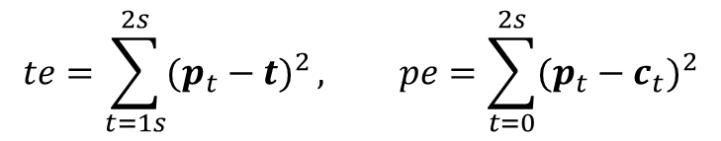
Separate Training
Update prediction output weight with prediction error;
Update input and recurrent weights with target error
MOTOR CORTEX
C
PE
P
TE
T
$$te=\sum_{t=1s}^{2s}{{(p_{t}−t)}^{2}}, pe=\sum_{t=0}^{2s}{{(p_{t}−c_{t})}^{2}}$$

Slide 13
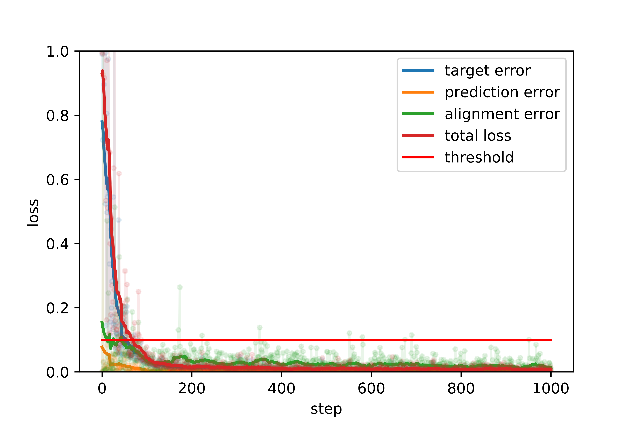
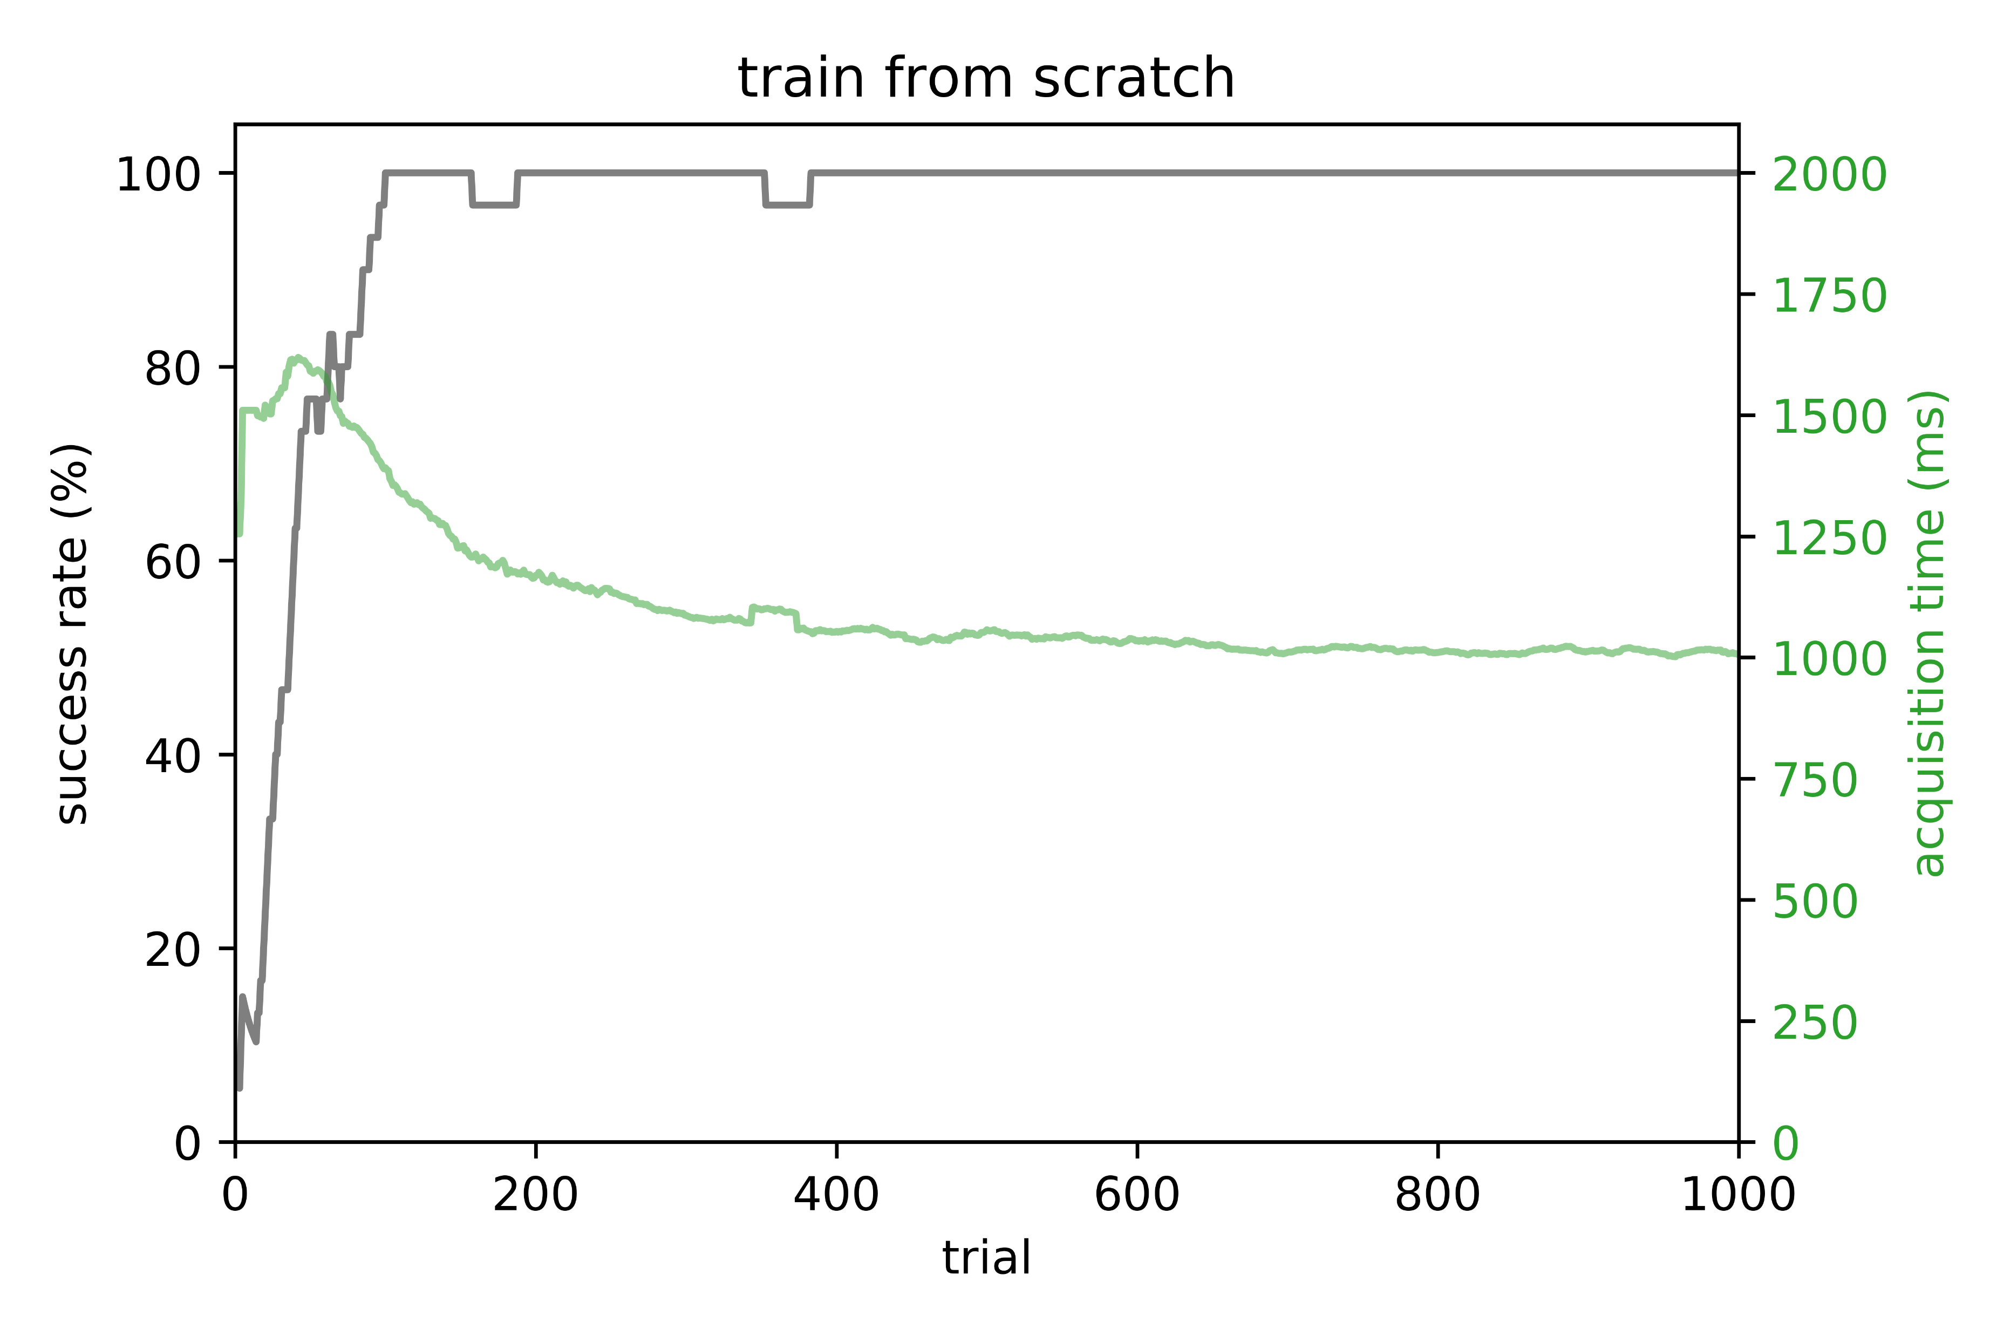
Training from scratch

Slide 14
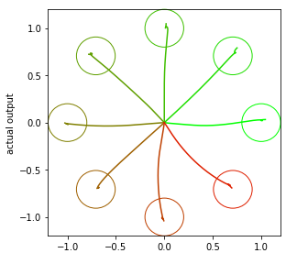
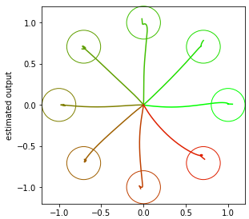
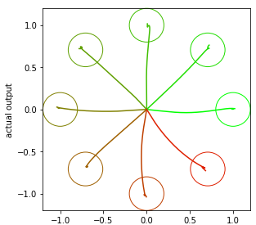
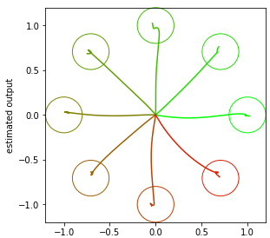
Prediction movement
Estimation using 10 factors
Training from scratch
Cursor movement
Estimation using 10 factors

Slide 15
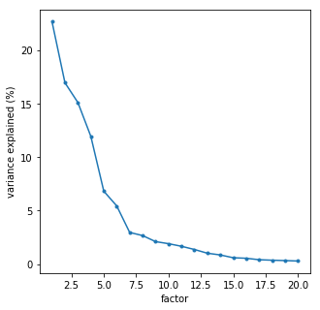
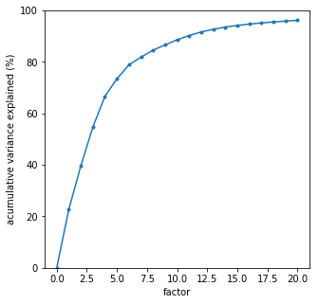
Factor analysis on neural activity

Slide 16
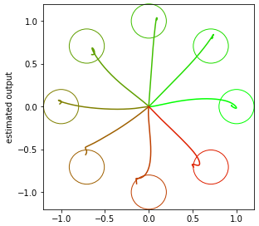
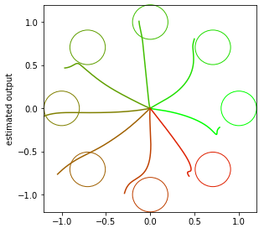
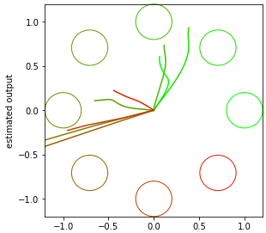
Cursor movement
Estimation using 10 factors
Estimation using 5 factors
Estimation using 3 factors
Estimation using 2 factors

Slide 17
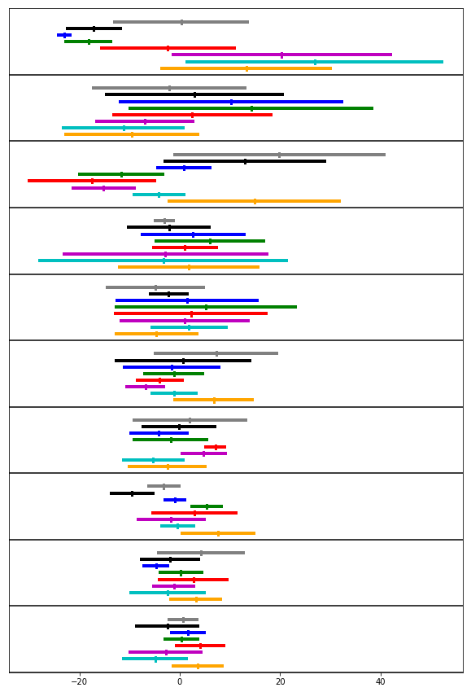
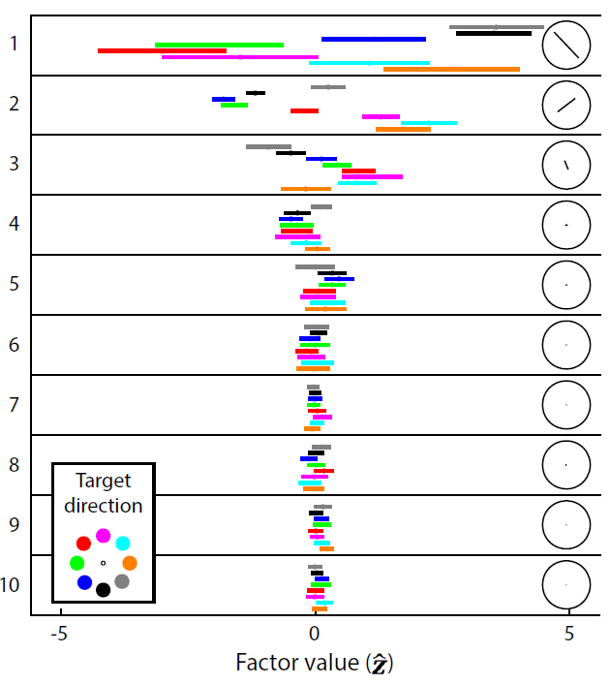
Ref: Yu, Batista, etc. Nature, 2014

Slide 18
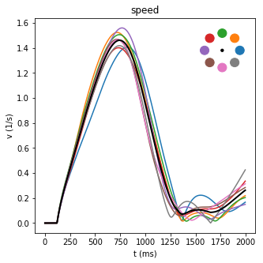
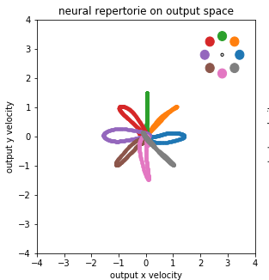
Output profile

Slide 19
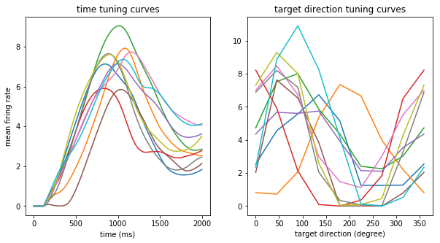
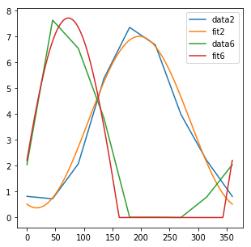
Firing rates have cos tuning curve

Slide 20
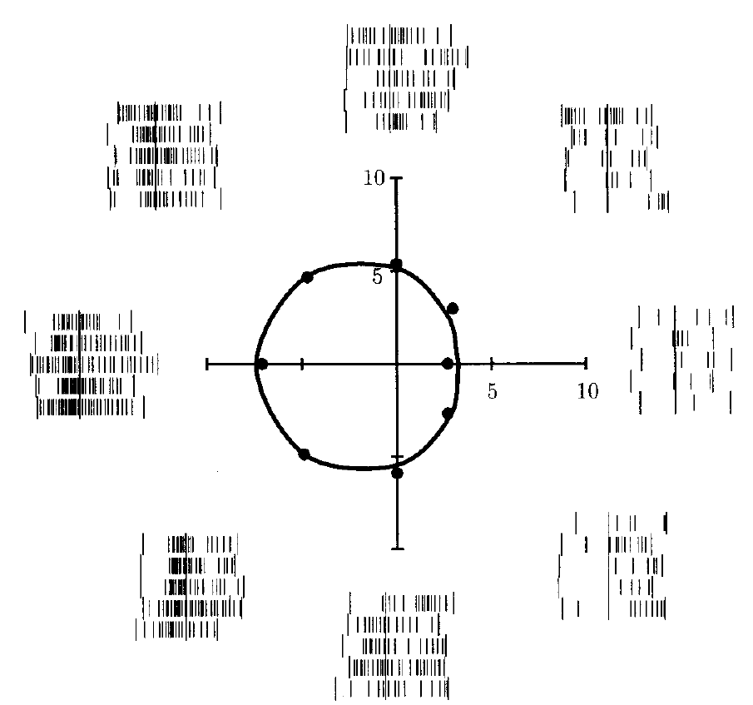
Firing rates have cos tuning curve
Ref: Moran, Schwartz. APS, 1999

Slide 21
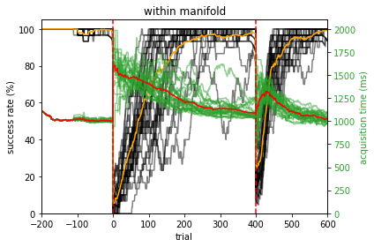
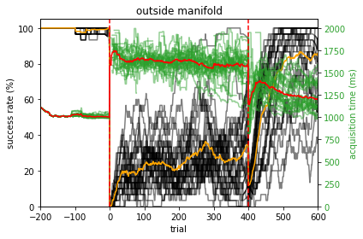
Learning result

Slide 22
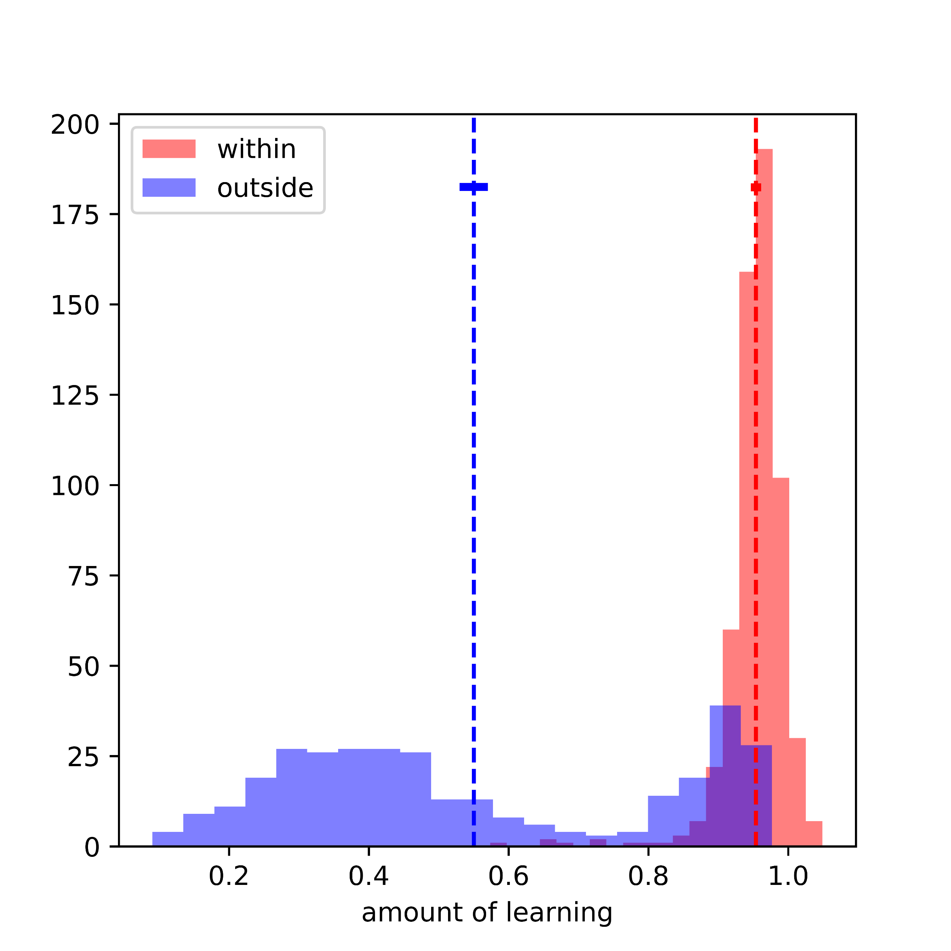
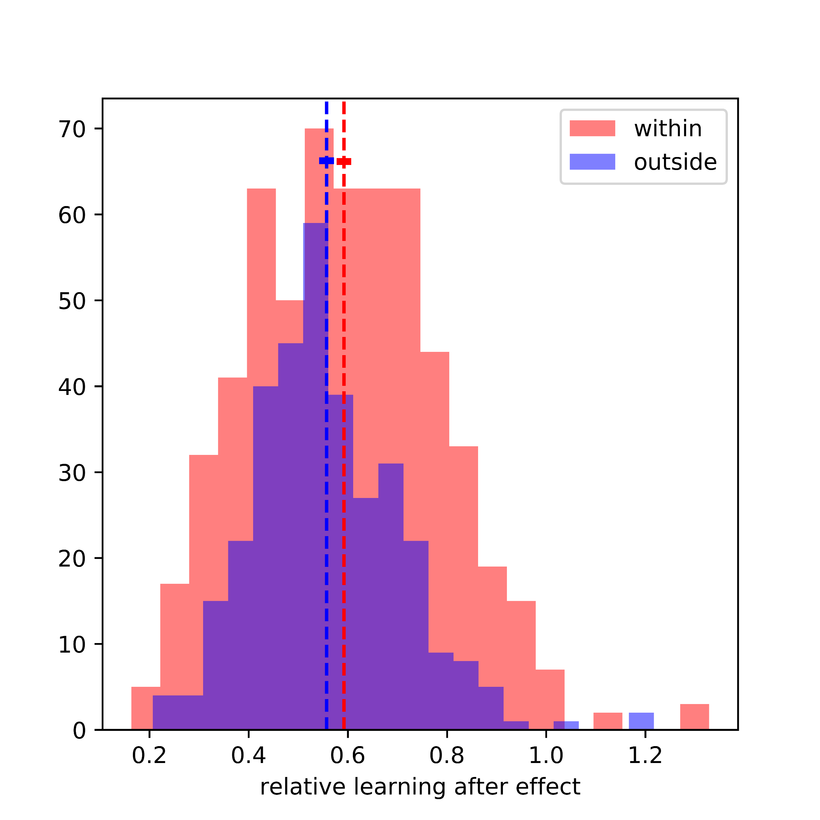

Slide 23
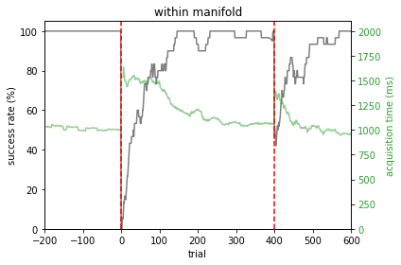
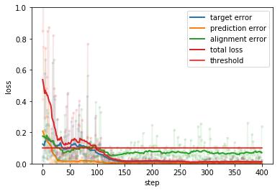
Training on within-manifold perturbation

Slide 24
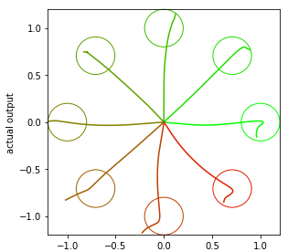
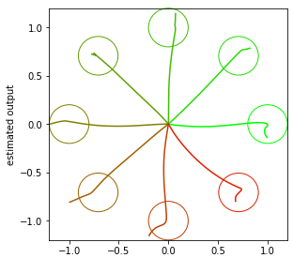
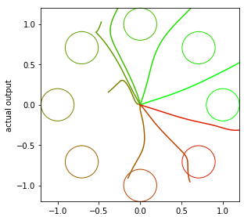
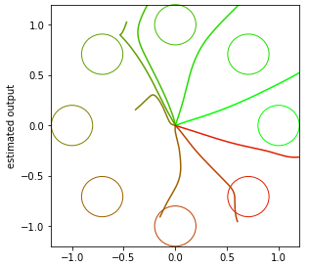
Within-manifold
Prediction movement
Estimation using 10 factors
After perturbation, Before training
Cursor movement
Estimation using 10 factors

Slide 25




Within-manifold
Prediction movement
Estimation using 10 factors
After perturbation, After training
Cursor movement
Estimation using 10 factors

Slide 26




Within-manifold
Prediction movement
Estimation using 10 factors
After training, first trial of washout block
Cursor movement
Estimation using 10 factors

Slide 27
Correction for the movement error
Cursor movement decoded with intuitive mapping can be treated as intended movement
Cursor movement
Before perturbation
Cursor movement
After perturbation before learning
Cursor movement
After learning, washout block

Slide 28



Variance explained by the latent space
Before learning
After learning

Slide 29


Slide 30


Training on outside-manifold perturbation

Slide 31




Outside-manifold
Prediction movement
Estimation using 10 factors
After perturbation, Before training
Cursor movement
Estimation using 10 factors

Slide 32




Outside-manifold
Prediction movement
Estimation using 10 factors
After perturbation, After training
Cursor movement
Estimation using 10 factors

Slide 33




Outside-manifold
Prediction movement
Estimation using 10 factors
After training, first trial of washout block
Cursor movement
Estimation using 10 factors

Slide 34


Variance explained by the latent space
Before learning
After learning

Slide 35
Two step learning: first prediction, then adaptation

Slide 36
Conclusion
Model prediction: animals learn to adapt to perturbation by first generating a comprehensive estimation of the BCI readout, then generating activity suitable to this estimated readout and desired movement.
Hypothesis: For the outside manifold part of the perturbation, it is difficult for the activity to find the decoding manifold, hence hard to make an accurate prediction of the readout

Slide 37
Future Work
Explore the two step learning hypothesis
Explore alternative architectures, without constraining how the updates are made
Test reassociation hypothesis
Whether the model can learn outside-manifold perturbation is perturbation and learning rate dependent, why?
Train the network with output perturbation (bias) from the beginning in order to make the network do online correction for the motor error
Do analysis on z scored activity

Slide 38
Thanks
Vishwa for his patient, enlightening and inspiring guidance
Xiaojing, Yota, Sean and Jorge for their very helpful advise

